Slide 1
The Holy Sacrifice of the Mass
(ver. 2)
Dcn. Ciso Macia
12/2/24

Slide 2
Why Do We Need the Mass?
God created man out of his will and pleasure
Originally, man was going to be in the direct presence of God
No Mass was necessary then
But original sin did occur
God’s attribute:
  Infinitely merciful
  Infinitely just
Think about me robing a bank

Slide 3
Why Do We Need the Mass?
God begins a plan of restoration
God allows man to change his ways, with no success
He starts with a small and insignificant group of people
He says to them, “I will be your God, and you will be my people”
Send them prophets to begin this formation process

Slide 4
Why Do We Need the Mass?
These chosen people continue to offend God and their brother and sisters
Head of household would travel once a year to Jerusalem, to atonement for his sins, and the sins of his family
Definition of atonement
  reparation for a wrong or injury.
  (in religious contexts) reparation or expiation for sin.

Slide 5
Why Do We Need the Mass?
Head of household would bring a unblemished lamb (or buy it close to Jerusalem), give it to the priest at the Temple
Priest would sacrifice the unblemished lamb as on offering for his own sins (the priest’s) and the sins of the head of household and his family
Not a perfect sacrifice – but that is all they could do

Slide 6
Why Do We Need the Mass?
Fast forward:
This is the reason why when John the Baptist encounters Jesus:
  The next day he saw Jesus coming toward him and said, “Behold, the Lamb of God, who takes away the sin of the world
  John 1:29

Slide 7
Why Do We Need the Mass?
God begin to tell the people, through the prophets, that one day a Messiah will come, who will offer the perfect sacrifice
You and I know that that Messiah was Jesus. He offered the perfect sacrifice for our sins
And we when we participate I the Mass, we are basically transported back to his crucifixion and resurrection

Slide 8
Why Do We Need the Mass?
We are witnessing the Tridium: Jesus’ suffering, death (calvary) and resurrection (all one event)
That is why the Tridium begins with the evening Mass of the Lord’s Supper (Holy Thursday) and ends at Easter Sunday
The Mass is often referred with the source and summit of our faith

Slide 9
..But before We Begin…
Realize that we are dealing with a mystery
What is a (religious) mystery
A mystery isn’t a truth of which we cannot know anything, but it is a truth of which we cannot know EVERYTHING!
  Frank Sheed, author of Theology for Beginners
My first encounter with a mystery

Slide 10
Structure of the Mass

Slide 11
The Mass Can Be Divided in Two Major Parts
Liturgy of the Word
Liturgy of the Eucharist
Some Catholic churches communicate the importance of both components in the construction of the altar
  St. Joseph Maronite Catholic Church
  Phoenix

Slide 12
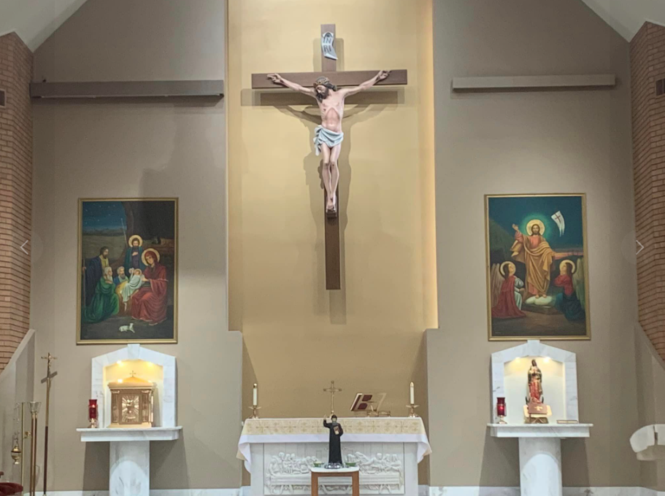
St. Joseph Maronite Catholic Church (Phoenix)

Slide 13
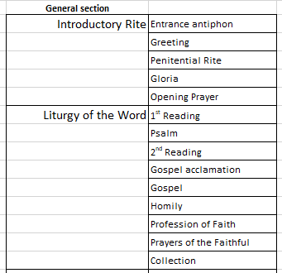
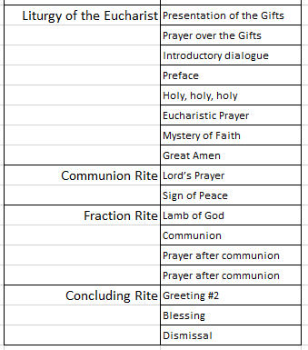
Parts of the Mass

Slide 14
WHY DO WE GO TO MASS - 12 REASONS

Slide 15
To give glory to God the Father: ADORATION
Jesus Christ, with his humanity, gave perfect glory to God the Father from the cross, and he continues to do so from the altar. If you unite yourself to him, you will be offering a perfect sacrifice of adoration and praise. Pay special attention to the Gloria and the Sanctus.

Slide 16
To thank him
And all the good things we have come from him: life, family, sanctifying grace, faith, the sacraments, and the gift of his Mother...and so many other natural and supernatural gifts. It is good to give thanks. It is good to thank each person of the Trinity.

Slide 17
To make up-ask forgiveness for the our sins, and the sins of men
Jesus is perfect God and perfect Man. He is all-holy. Therefore he has not and could not have been guilty of any sin. But, as the Holy Scriptures says, he took our sins on himself and made up for them. He did penance for us by dying on the cross. If we want to take part properly in the Holy Mass, we must be sorry for our sins. The penitential act helps us to obtain pardon for present venial sins as well as to stir up new sorrow for past sins that have already been forgiven.

Slide 18
To ask him for graces for us
Christ's prayer is always effective because it is simply impossible that God the Father should not listen to the prayer of his beloved Son. Jesus prayed for us on the cross. He continues praying for us on the altar. When we pray in the Holy Mass, we are uniting our prayers to that of Jesus, we can be sure that our requests will be heard by God the Father. During the Petition of the Faithful we pray for the needs of the world, Church, country or world, diocese, parish and individuals

Slide 19
To hear God speak to us and to learn about him-come to know who He is
Holy Scripture is God's word. God speaks to us in the readings taken from the inspired books (Old Testament, Psalms, Epistles, Gospels, Book of Revelation (prophetic book)). Listening to these readings we learn of God’s love for us, that he never abandon us, and the great plans that he has for each one of us. As a result, we can know what we have to believe and what we have to do, in order to get to heaven, and to experience the abundant life here on earth, as promised in the Scriptures.

Slide 20
To encounter Christ in multiple ways
- Through his Word
- In his Church-through the priest
- Through the Eucharist receiving His Body and Blood – His very self - into ourselves
- Through the presence of Christ in our brothers and sisters

Slide 21
We offer ourselves for the Sanctification of the World-to be joined together in the Sacrifice of Christ
During the offertory, we can offer God our personal joys and our sorrows, and allow him to do with them as he wishes. This includes our work, our studies, our needs, our struggles, and even our weaknesses.

Slide 22
To encourage us in our walk, and to reassure us to the gift of salvation
At Mass we are reminded of the gift of salvation that Christ has earned, and made possible for us, through his suffering, death and resurrection

Slide 23
It provides us with an outline of what we believe
When we pray the Creed, we are reminded of the nature of God, and a short history of how God has rescued us from our sinfulness, from that inclination that we are born with (because Original Sin)

Slide 24
It provides an opportunity for us to offer our material gifts
During the offertory, we offer our gifts (3 T’s: time, treasure and talents) for the work of the Church

Slide 25
It provides an opportunity for us to witness the work of the Holy Spirit
When we are at Mass, the celebrant (the priest), acting In persona Christi, invokes the Holy Spirit to transform the bread and wine into the body, blood, soul and divinity of Christ

Slide 26
To increase in knowledge of our Faith and Scriptures
When we listen to the homily, we grow in knowledge of our Faith and Scriptures. We are also given practical examples on how to apply our Faith

Slide 27
QUESTIONS?

